Slide 1
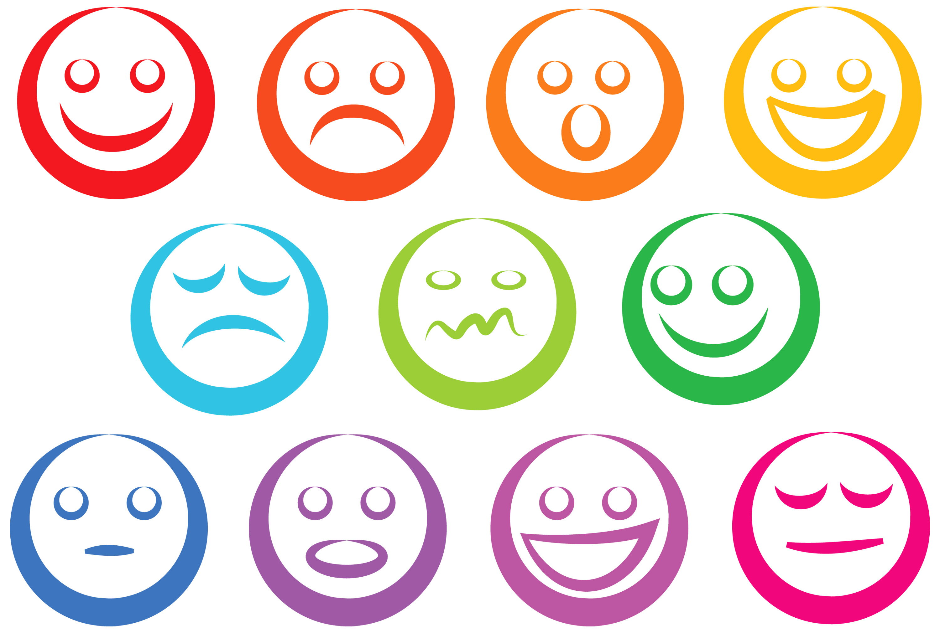

Slide 2
Analyzing Personality through Social Media Profile Picture Choice
Anuj Khasgiwala

Slide 3
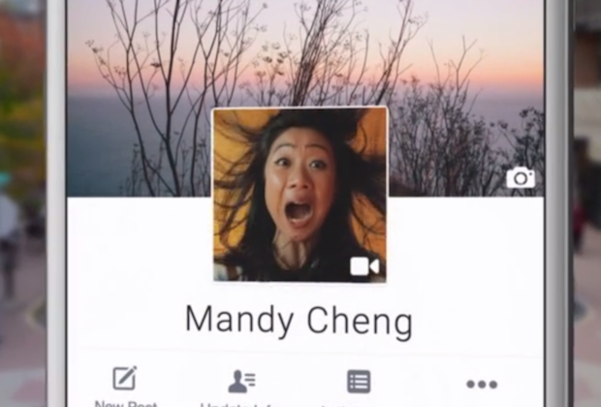
Motivation
Social media images portrays personality
Audience: Twitter users
Dataset: 66000 users
How: using tweets
Interpretation: analysis on aesthetic and facial features and control for demographic variation in image features and personality

Slide 4
Introduction
Freedom to speak or convey
Presentation depends on psychological traits and represent persona
Previous work on user traits(age, gender, occupation etc.)
Choice of Photos are type of behavior associated at least in part with personality expressed by five factor model
Digman Big Five – consisting of openness to experience, conscientiousness, extraversion, agreeableness and neuroticism

Slide 5
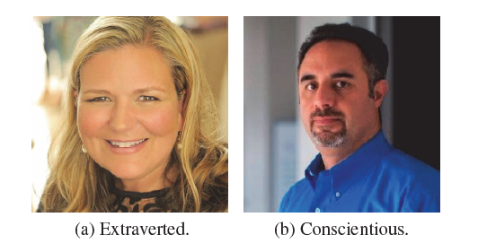
Relation between Personality and Picture

Slide 6
Relation between Personality and Picture
Extravert
Enjoy interacting
High group visibility
Energetic
Use picture involving other people or the once that express more positive emotions
may be more inclined to choose unconventional images and poses, as a general inclination of this type of people for art and novelty.
Conscientiousness
More orderly
Prefer planned behavior
Use frontal photography of themselves
Neuroticism is associated with negative emotions, which could also be reflected through users choices of profile images

Slide 7
Features
Colors, aesthetics, facial presentation, emotions
Compare features with Big Five model.
Previous studies conclusion
Personality traits are predictable from images, demonstrating correlation between personality and profile picture.
features of the models provide no interpretability and thus are not useful for psychologists who wish to understand the underlying correlations and generate hypotheses for further testing.
Data set was very limited size and user diversity

Slide 8
Related Work
Most studies in psychology focused on facial expressions as people frequently use facial characteristics for personality attributions, while some studies consider pose of person

Slide 9
Strength | Weekness
Used great example to explain the correlation between personality traits and profile picture
Overcame the problem of previous work by taking 60000 users

